Slide 1
Population ageing & international capital flows
Financial International Markets Justus Senck & Johanna Witting
Authors: David Domeij & Martin Flodén

Slide 2
Table of content
Introduction
Background
Explanation of the Model
Solving the model
Outcome
Future predictions
Summary
Exam question
References

Slide 3
Introduction & background
Main objective: Examine the relationship between demographics & savings, investments and international capital flows.
Lyfe cykle theory: consumption as a fraction of income varies with age
Previous research - no explenation of historical data
Future demographics - aging population
Neoclassical model

Slide 4
Model & Assumptions
Assumptions: 1. 18 OECD countries and 1 country representing the rest of the world 2. Overlaping genereations with same life-cykle problems 3. Exogenous demographic development 4. Production technology is identical across countries 5. Immobile labour but capital moves freely Equilibrium model Three parameters The Household´s Optimization Problem The Pension system The Capital & Asset Market

Slide 5
Houshold optimization problem
- Discount factor - Bequests - Labour supply in efficency - Houshold assets + return - wages, income, social security tax & pension benefits
Enters labour market at age 20
Children raised
Survival probability - stochastic
Adults maximize the life-time utility
Households aged 20–49 share the burden of raising children, and, following OECD (1982), child consumption is 50% of adult consumption.

Slide 6
Pension system
Pay-as-you-go system
Flat pension tax
Tax return distribution as a lump-sum
Retirement age 65+

Slide 7
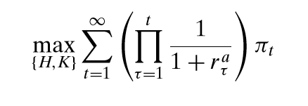
Product and Asset Market
Labour - H Capital - K World market price - r
→ Maximize the discounted value of dividence

Slide 8
Assumptions
Total factor productivity growth of 1% per year
Set up parameters in the initial state to match real data in 1990:
Capital output ratio 2.74 (worldbank 1990)
Investment share 0.19 (OECD 2004)
Capital moves freely between countries
All countries have an identical pay-as-you-go pension system
In 2000: 7% and in 2050: 13 % average social security tax rate
To isolate the effect of demographic change the model ignores other important factors like: business cycle fluctuations, long-term growth trends and volatile fiscal policy

Slide 9
Solving the model
Set up the initial steady state, which is calibrated to match 1950 values.
Get the initial capital stocks for the 19 countries, as well as the initial distribution of asset holdings across households of different ages.
Guess an interest rate path for all years as basis.
Solve for the consumption–savings decisions for all households in all countries.
Sum up all asset holdings implied by household optimization to obtain a path for the total world asset holdings, and similarly we sum all capital stocks and all firm values.
If asset holdings do not equal the sum of capital stocks and firm values in each period, an equation solver updates the interest rate path and starts over.

Slide 10
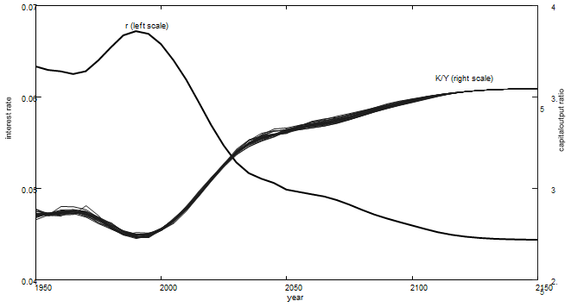
baseline calibration of the model
equilibrium interest rate path and capital output ratio
When fraction of prime-age workers fall:
productivity of capital and interest rate goes down
capital-output ratio goes up
Notes:
Model uses this data to calculate the current account balances of the countries and showing the impact of the demographic change on the international capital flows like this.

Slide 11
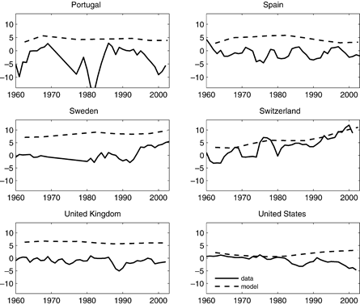
Outcomes - model compared to real world data
A substantial fraction of current account fluctuations is explained by the model. More than 10%
Considering just the period 1985–2002 -> the results improve to 17% of the current account fluctuations
Limitations of the model: real world factors like fiscal policy
Notes:
(In the real world, current accounts are determined by many factors in addition to demographic change, for example, business cycle fluctuations, long-term growth trends, and volatile fiscal policy.)
During the 1970s and 1980s, however, many countries removed restrictions on international capital flows, and in particular, the European economies became moreinternationallyintegrated

Slide 12
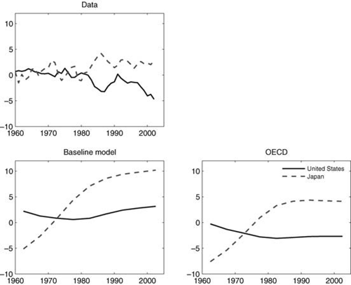
closer look - current account balances of Japan and United States
In baseline model: all countries included -> capital flows to developing countries results in account surplus for the U.S.
With only OECD countries the model gets more exactly and caught the real development
See impact of demographic change

Slide 13
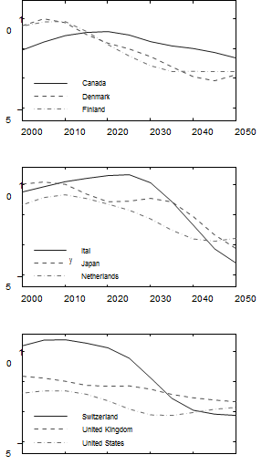
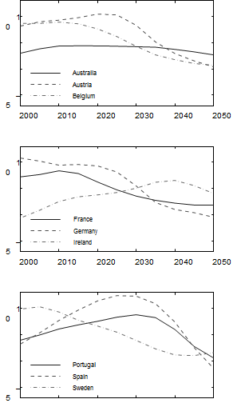
future projections
current account improvements in Southern Europe and Ireland (increasing fraction of prime age workers in the coming decades and peak around 2020
Downward pressure in U.S. and Scandinavia (fraction of prime aged workers already peaked or is about to peak
Capital flows explained by the relative timing of population in different countries
No exact forecasts as other factors not in account, like a widely expected policy change.

Slide 14
conclusion/outcome
Model focuses on demographic change and ignores other factors
Model can explain a substantial fraction of capital flows at low frequencies
Model explains history rather well -> provide insights on the future development

Slide 15
Research questions
Briefly explain the three parameters behind the model
Why does the projections between the general Baseline Model and the Model of the OECD countries differ?
As the population ages, what will happen to the capital flows according to the authors?

Slide 16
References
Domeij and Flodén (2006) Population aging and international capital flows 6 International Economic Review, 47, 3, 1013-1032.
Groome, W. T., Blancher, N., Ramlogan, P., and Khadarina, O. (2006). Population ageing, the structure of financial markets and policy implications. In Kent et al. (Eds) DEMOGRAPHY AND FINANCIAL MARKETS (p. 345-371)

